Slide 1




p
o
i
s
h
n
c
Welcome to Ms. Birdie’s Phonics Class

Slide 2
A
Lesson objectives
D
You will review letter sounds you’ve learned before, and learn to identify short-vowel phonetic rules in this lesson.
You should be able to apply short-vowel rules in spelling and reading words, and to compare different short-vowel sounds.
B
A
C
S

Slide 3
A
D
Letter Sounds
review
B
A
S
C

Slide 4

Click the link below and
click the first episode to watch
http://www.bbc.co.uk/cbeebies/alphablocks/#/lb/alphablocks/alphablocksgames
B
A
A
S
C
D

Slide 5

Short Vowels
B
CVC blending
A
A
S
C
D

Slide 6

short a
short e
cat
mat
leg
met
dad
pan
red
pen
B
Click the sound icon to hear sounds
A
A
S
C
D

Slide 7

short i
short o
fit
big
log
mop
mix
pin
rod
pot
B
Click the sound icon to hear sounds
A
A
S
C
D

Slide 8

short u
bus
hug
nut
cub
B
Click the sound icon to hear sounds
A
A
S
C
D

Slide 9
Compare and Say these words
mat
met
pot
pet
pen
pin
cop
cup
sit
set
cut
cot
B
A
A
S
C
D

Slide 10


Spin & Say
fox
hug
sad
get
SPIN
tip
mix
bus
cop
T
A
S
C
A
D

Slide 11
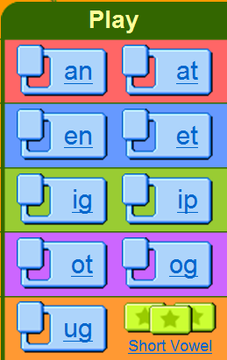
Take a break and play a game
Click the link and play the games related to short-vowel sounds.
http://www.starfall.com/n/level-a/learn-to-read/load.htm?f
B
A
A
S
C
D

Slide 12
Give yourself a small quiz
1. b_s 2. h_t 3. f_g 4. m_p
1. bus 2. hot 3. fig 4. map
5. l_g 6. b_t 7. k_d 8. j_t
5. leg 6. but 7. kid 8. jet
B
A
A
S
C
D

Slide 13

Assignment 1
Click the link below and review letter sounds. http://www.starfall.com/n/level-k/index/load.htm?f
Finish worksheet1 in the assignment folder under the document button in Blackboard, and then send it to me via email.
Answer the questions posted on discussion board.
B
A
A
C
S
D

Slide 14


p
o
i
s
h
n
c
Hope you did
a great job today!!!
Goodbye

